Slide 1
Review: Pointers & Dynamic Data
A pointer variable is a variable whose value is the address of a location in memory
int x;
  x = 5;
int* ptr1;
ptr1 = &x;
int* ptr2;
ptr2 = ptr1;
*ptr1 = 6;
cout << ptr1 << endl;
cout << *ptr2 << endl;
int* ptr3;
ptr3 = new int;
*ptr3 = 5;
delete ptr3;
ptr3 = NULL;
int *ptr4;
ptr4 = new int[5];
ptr4[0] = 100;
ptr4[4] = 123;
delete [] ptr4;
ptr4 = NULL;

Slide 2
Review: Reference Types
Reference Types
  Alias for another variable
  Must be initialized when declared
  Are primarily used as function parameters
  int main (void){
  int a1 = 5, a2 = 10;
  int *a3 = new int;
  *a3 = 15;
  int &a4 = a3;
  cout << a1 << a2 << a3 << endl;
  increment(a1, a2, a3);
  cout << a1 << a2 << a3 << endl;
  delete a3; a3 = NULL;
  return 0;
  }
void increment(int b1, int &b2, int *b3)
{
b1 += 2;
b2 += 2
*b3 += 2;
}

Slide 3
Object-Oriented Programming
Introduction to Classes
Class Definition
Class Examples
Objects
Constructors
Destructors

Slide 4
Class
The class is the cornerstone of C++
  It makes possible encapsulation, data hiding and inheritance
Type
  Concrete representation of a concept
    Eg. float with operations like -, *, + (math real numbers)
Class
  A user defined type
  Consists of both data and methods
  Defines properties and behavior of that type
Advantages
  Types matching program concepts
    Game Program (Explosion type)
  Concise program
  Code analysis easy
  Compiler can detect illegal uses of types
Data Abstraction
  Separate the implementation details from its essential properties

Slide 5
Classes & Objects
class Rectangle
{
private:
int width;
int length;
public:
void set(int w, int l);
int area();
};
Objects: Instance of a class
Rectangle r1;
Rectangle r2;
Rectangle r3;
……
int a;

Slide 6
Define a Class Type
class class_name
{
permission_label:
member;
permission_label:
member;
...
};
class Rectangle
{
private:
int width;
int length;
public:
void set(int w, int l);
int area();
};
Header
Body

Slide 7
Class Definition
Data Members
Can be of any type, built-in or user-defined
non-static data member
  Each class object has its own copy
static data member
  Acts as a global variable
  One copy per class type, e.g. counter

Slide 8
Static Data Member
class Rectangle
{
private:
int width;
int length;
static int count;
public:
void set(int w, int l);
int area();
}
Rectangle r1;
Rectangle r2;
Rectangle r3;
count
r1
r2
width
length
width
length
width
length
r3

Slide 9
Class Definition
Member Functions
Used to
  access the values of the data members (accessor)
  perform operations on the data members (implementor)
Are declared inside the class body
Their definition can be placed inside the class body, or outside the class body
Can access both public and private members of the class
Can be referred to using dot or arrow member access operator

Slide 10
Define a Member Function
class Rectangle
{
private:
int width, length;
public:
void set (int w, int l);
int area() {return width*length; }
};
class name
member function name
void Rectangle :: set (int w, int l)
{
width = w;
length = l;
}
inline
r1.set(5,8);
rp->set(8,10);
scope operator

Slide 11
Class Definition
Member Functions
const member function
  declaration
    return_type func_name (para_list) const;
  definition
    return_type func_name (para_list) const { … }
    return_type class_name :: func_name (para_list) const { … }
  Makes no modification about the data members (safe function)
  It is illegal for a const member function to modify a class data member

Slide 12
Const Member Function
class Time
{
private :
int hrs, mins, secs ;
public :
void Write ( ) const ;
} ;
function declaration
function definition
void Time :: Write( ) const
{
cout <<hrs << “:” << mins << “:” << secs << endl;
}

Slide 13
Class Definition - Access Control
Information hiding
  To prevent the internal representation from direct access from outside the class
Access Specifiers
  public
    may be accessible from anywhere within a program
  private
    may be accessed only by the member functions, and friends of this class
  protected
    acts as public for derived classes
    behaves as private for the rest of the program

Slide 14
class Time Specification
class Time
{
public :
void Set ( int hours , int minutes , int seconds ) ;
void Increment ( ) ;
void Write ( ) const ;
Time ( int initHrs, int initMins, int initSecs ) ; // constructor
Time ( ) ; // default constructor
private :
int hrs ;
int mins ;
int secs ;
} ;

Slide 15
Class Interface Diagram
Time class
Set
Private data:
hrs
mins
secs
Increment
Write
Time
Time

Slide 16
Class Definition
Access Control
The default access specifier is private
The data members are usually private or protected
A private member function is a helper, may only be accessed by another member function of the same class (exception friend function)
The public member functions are part of the class interface
Each access control section is optional, repeatable, and sections may occur in any order

Slide 17
What is an object?
OBJECT
set of methods
(member functions)
internal state
(values of private data members)
Operations
Data

Slide 18
Declaration of an Object
class Rectangle
{
private:
int width;
int length;
public:
void set(int w, int l);
int area();
};
main()
{
Rectangle r1;
Rectangle r2;
r1.set(5, 8);
cout<<r1.area()<<endl;
r2.set(8,10);
cout<<r2.area()<<endl;
}

Slide 19
Another Example
#include <iostream.h>
class circle
{
private:
double radius;
public:
void store(double);
double area(void);
void display(void);
};
  // member function definitions
  void circle::store(double r)
  {
  radius = r;
  }
  double circle::area(void)
  {
  return 3.14*radius*radius;
  }
  void circle::display(void)
  {
  cout << “r = “ << radius << endl;
  }
  int main(void) {
  circle c; // an object of circle class
  c.store(5.0);
  cout << "The area of circle c is " << c.area() << endl;
  c.display();
  }

Slide 20
Declaration of an Object
class Rectangle
{
private:
int width;
int length;
public:
void set(int w, int l);
int area();
};
r1 is statically allocated
main()
{
Rectangle r1;
r1.set(5, 8);
}
r1
width
length
width = 5
length = 8

Slide 21
Declaration of an Object
class Rectangle
{
private:
int width;
int length;
public:
void set(int w, int l);
int area();
};
r2 is a pointer to a Rectangle object
main()
{
Rectangle r1;
r1.set(5, 8);
Rectangle *r2;
r2 = &r1;
r2->set(8,10);
}
//dot notation
//arrow notation
5000
r1
r2
width
length
width = 5
length = 8
width = 8
length = 10
6000
???
5000

Slide 22
Declaration of an Object
class Rectangle
{
private:
int width;
int length;
public:
void set(int w, int l);
int area();
};
r3 is dynamically allocated
main()
{
Rectangle *r3;
r3 = new Rectangle();
r3->set(80,100);
delete r3;
r3 = NULL;
}
//arrow notation
r3
6000
5000
???
5000
???
NULL
width
length
width = 80
length = 100

Slide 23
Object Initialization
1. By Assignment
#include <iostream.h>
class circle
{
public:
double radius;
};
Only work for public data
members
No control over the operations
on data members
int main()
{
circle c1; // Declare an instance of the class circle
c1.radius = 5; // Initialize by assignment
}

Slide 24
Object Initialization
#include <iostream.h>
class circle
{
private:
double radius;
public:
void set (double r)
{radius = r;}
double get_r ()
{return radius;}
};
2. By Public Member Functions
  int main(void) {
  circle c; // an object of circle class
  c.set(5.0); // initialize an object with a public member function
  cout << "The radius of circle c is " << c.get_r() << endl;
  // access a private data member with an accessor
  }

Slide 25
Declaration of an Object
class Rectangle
{
private:
int width;
int length;
public:
void set(int w, int l);
int area();
}
r2 is a pointer to a Rectangle object
main()
{
Rectangle r1;
r1.set(5, 8);
Rectangle *r2;
r2 = &r1;
r2->set(8,10);
}
//dot notation
//arrow notation
r1 and r2 are both initialized by
public member function set

Slide 26
Object Initialization
class Rectangle
{
private:
int width;
int length;
public:
Rectangle();
Rectangle(const Rectangle &r);
Rectangle(int w, int l);
void set(int w, int l);
int area();
}
3. By Constructor
Default constructor
Copy constructor
Constructor with parameters
They are publicly accessible
Have the same name as the class
There is no return type
Are used to initialize class data
members
They have different signatures

Slide 27
Object Initialization
When a class is declared with no constructors,
the compiler automatically assumes default
constructor and copy constructor for it.
class Rectangle
{
private:
int width;
int length;
public:
void set(int w, int l);
int area();
};
Default constructor
Rectangle :: Rectangle() { };
Copy constructor
Rectangle :: Rectangle (const Rectangle & r)
{
width = r.width; length = r.length;
};

Slide 28
Object Initialization
Initialize with default constructor
class Rectangle
{
private:
int width;
int length;
public:
void set(int w, int l);
int area();
}
Rectangle r1;
Rectangle *r3 = new Rectangle();
Initialize with copy constructor
Rectangle r4;
r4.set(60,80);
Rectangle r5 = r4;
Rectangle r6(r4);
Rectangle *r7 = new Rectangle(r4);

Slide 29
Object Initialization
class Rectangle
{
private:
int width;
int length;
public:
Rectangle(int w, int l)
{width =w; length=l;}
void set(int w, int l);
int area();
}
If any constructor with any number of parameters is declared, no default constructor will exist, unless you define it.
Rectangle r4; // error
Initialize with constructor
Rectangle r5(60,80);
Rectangle *r6 = new Rectangle(60,80);

Slide 30
Object Initialization
Write your own constructors
class Rectangle
{
private:
int width;
int length;
public:
Rectangle();
Rectangle(int w, int l);
void set(int w, int l);
int area();
}
Rectangle :: Rectangle()
{
width = 20;
length = 50;
};
Rectangle *r7 = new Rectangle();
r7
6000
???
5000
5000
width
length
width = 20
length = 50

Slide 31
Object Initialization
class Account
{
private:
char *name;
double balance;
unsigned int id;
public:
Account();
Account(const Account &a);
Account(const char *person);
}
With constructors, we have more
control over the data members
Account :: Account(const Account &a)
{
name = new char[strlen(a.name)+1];
strcpy (name, a.name);
balance = a.balance;
id = a.id;
};
Account :: Account(const char *person)
{
name = new char[strlen(person)+1];
strcpy (name, person);
balance = 0.0;
id = 0;
};
Account :: Account()
{
name = NULL; balance = 0.0;
id = 0;
};

Slide 32
So far, …
An object can be initialized by a class constructor
  default constructor
  copy constructor
  constructor with parameters
Resources are allocated when an object is initialized
Resources should be revoked when an object is about to end its lifetime

Slide 33
Cleanup of An Object
Destructor
class Account
{
private:
char *name;
double balance;
unsigned int id; //unique
public:
Account();
Account(const Account &a);
Account(const char *person);
~Account();
}
Account :: ~Account()
{
delete[] name;
}
Its name is the class name preceded by a ~ (tilde)
It has no argument
It is used to release dynamically allocated memory and to perform other "cleanup" activities
It is executed automatically when the object goes out of scope

Slide 34
Putting Them Together
class Str
{
char *pData;
int nLength;
public:
//constructors
Str();
Str(char *s);
Str(const Str &str);
//accessors
char* get_Data();
int get_Len();
//destructor
~Str();
};
Str :: Str() {
pData = new char[1];
*pData = ‘\0’;
nLength = 0;
};
Str :: Str(char *s) {
pData = new char[strlen(s)+1];
strcpy(pData, s);
nLength = strlen(s);
};
Str :: Str(const Str &str) {
int n = str.nLength;
pData = new char[n+1];
nLength = n; strcpy(pData,str.pData);
};

Slide 35
Putting Them Together
class Str
{
char *pData;
int nLength;
public:
//constructors
Str();
Str(char *s);
Str(const Str &str);
//accessors
char* get_Data();
int get_Len();
//destructor
~Str();
};
char* Str :: get_Data()
{
return pData;
};
int Str :: get_Len()
{
return nLength;
};
Str :: ~Str()
{
delete[] pData;
};

Slide 36
Putting Them Together
class Str
{
char *pData;
int nLength;
public:
//constructors
Str();
Str(char *s);
Str(const Str &str);
//accessors
char* get_Data();
int get_Len();
//destructor
~Str();
};
int main()
{
int x=3;
Str *pStr1 = new Str(“Joe”);
Str *pStr2 = new Str();
}

Slide 37
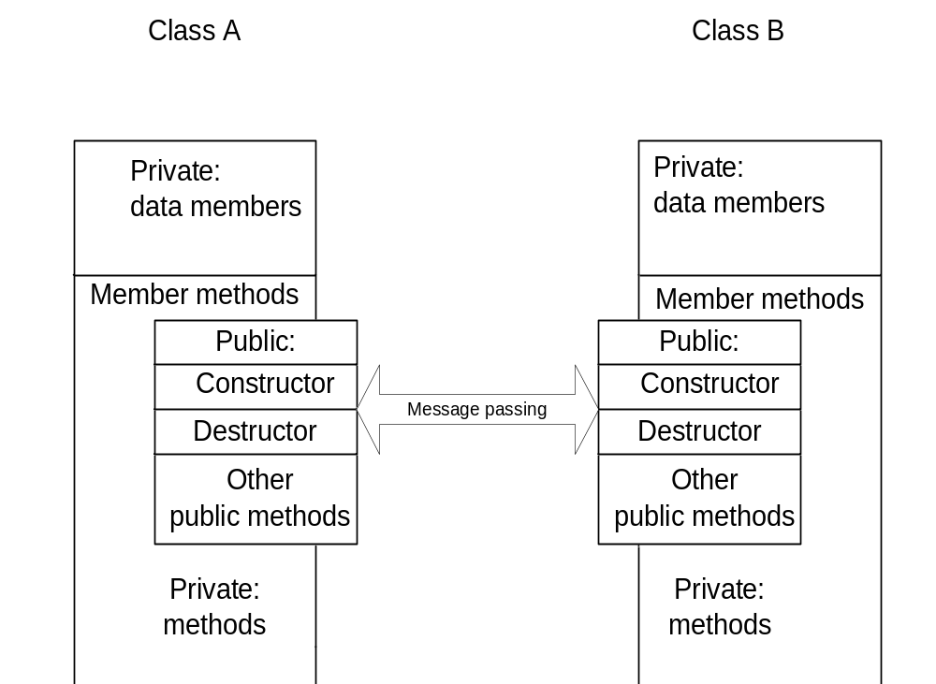
Interacting Objects

Slide 38
Working with Multiple Files
To improve the readability, maintainability and reusability, codes are organized into modules.
When working with complicated codes,
  A set of .cpp and .h files for each class groups
    .h file contains the prototype of the class
    .cpp contains the definition/implementation of the class
  A .cpp file containing main() function, should include all the corresponding .h files where the functions used in .cpp file are defined

Slide 39
Example : time.h
// SPECIFICATION FILE ( time .h )
// Specifies the data members and
// member functions prototypes.
#ifndef _TIME_H
#define _TIME_H
class Time
{
public:
. . .
private:
. . .
} ;
#endif

Slide 40
Example : time.cpp
// IMPLEMENTATION FILE ( time.cpp )
// Implements the member functions of class Time
#include <iostream.h>
#include “ time.h” // also must appear in client code
… …
bool Time :: Equal ( Time otherTime ) const
// Function value == true, if this time equals otherTime
// == false , otherwise
{
return ( (hrs == otherTime.hrs) && (mins == otherTime.mins)
&& (secs == otherTime.secs) ) ;
}
. . .

Slide 41
Example : main.cpp
// Client Code ( main.cpp )
#include “ time.h”
// other functions, if any
int main()
{
… …
}
Compile and Run
g++ -o mainExec main.cpp time.cpp

Slide 42
Separate Compilation and Linking of Files
specification file
main program
time.h
implementation file
main.cpp
time.cpp
#include “time.h”
Compiler
Compiler
main.o
time.o
Linker
mainExec

